Slide 1
Supply Chain Analysis
A comprehensive analysis to optimize supply chain performance

Slide 2
Project Overview
The Supply Chain Analysis project aims to provide actionable insights into the supply chain operations of a company. Using a detailed dataset, we analysed various aspects such as product sales, inventory management, supplier quality, shipping efficiency, and customer satisfaction. The results of these analyses help the company optimize its supply chain, reduce costs, and improve overall customer satisfaction
Objective: To analyze and improve the supply chain operations, focusing on reducing costs, enhancing efficiency, and increasing customer satisfaction.
Scope: Includes sales performance, inventory analysis, supplier performance, logistics, and customer insights.

Slide 3
Data Summary
Dataset Features:
The dataset contained the following key features:
Product Information: Product type, SKU, price, availability.
Sales Data: Number of products sold; revenue generated.
Inventory Metrics: Stock levels, order quantities, lead times.
Logistics Details: Shipping times, shipping carriers, shipping costs, transportation modes, and routes.
Supplier Details: Supplier names, defect rates, manufacturing costs.
Customer Information: Demographics of customers making purchases.
Quality Control: Inspection results and defect rates.

Slide 4
Analysis Approach
Step 1: Data Cleaning and Transformation
Step 2: Sales and Revenue Analysis
Step 3: Inventory Management Analysis
Step 4: Supplier and Location Analysis
Step 5: Quality Control Analysis
Step 6: Customer Demographics Analysis
Step 7: Shipping and Logistics Efficiency Analysis
Step 1: Data Cleaning and Transformation:
Data was extracted from a database and cleaned to ensure consistency and accuracy. Irrelevant characters (e.g., commas, percentage signs) were removed to convert data into usable formats.

Slide 5
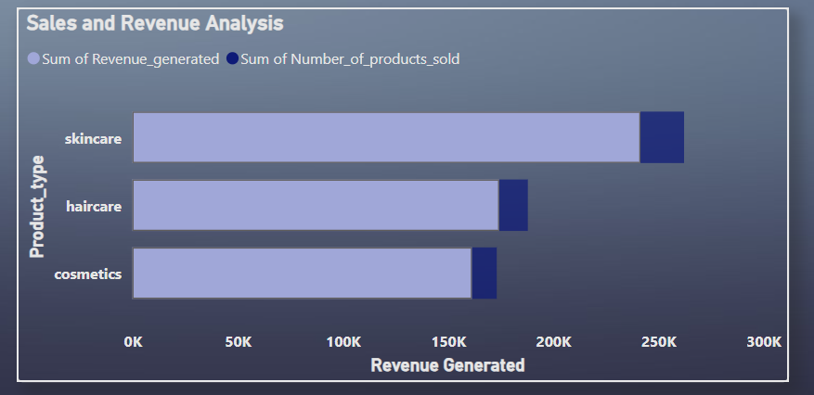
Step 2: Sales and Revenue Analysis
Overview: Analyzed the sales trends to identify the top-performing products and their
contribution to overall revenue.
Key Insight: Product Skincare and Haircare account for 60% of total sales, driving significant revenue.

Slide 6
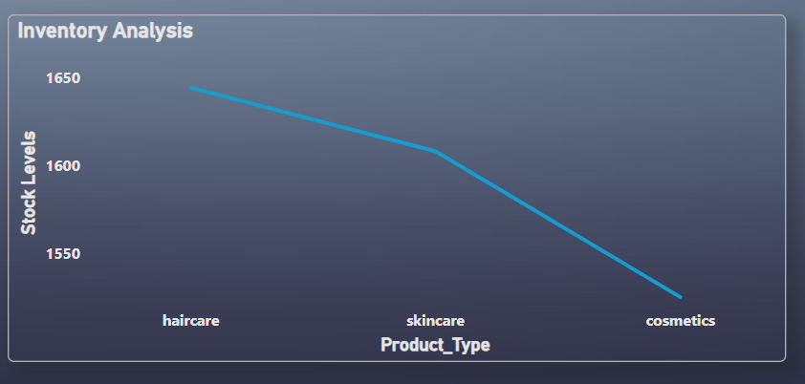
Step 3:Inventory Management
Overview: Stock levels and lead times were assessed to determine optimal inventory levels. This analysis highlighted products that required restocking and helped in maintaining an efficient inventory system
Key Insight: Product haircare often experiences stockouts, suggesting a need for increased reorder quantities.

Slide 7
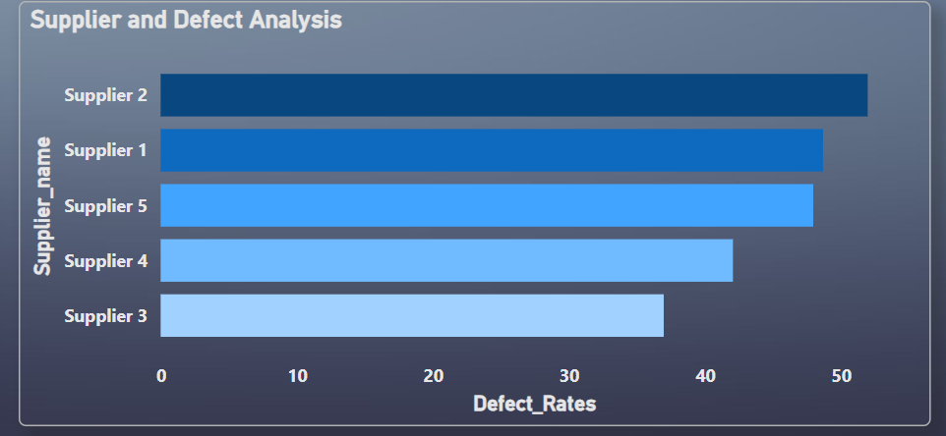
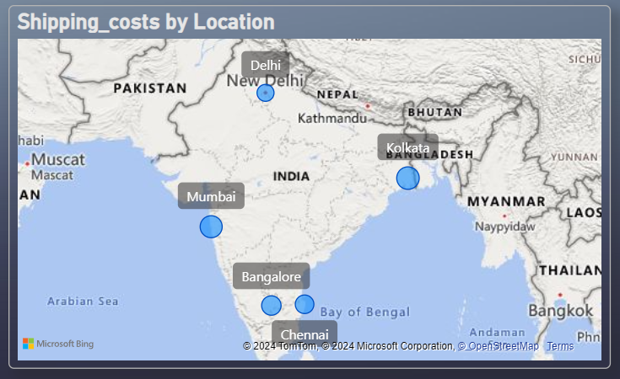
Step 4: Supplier and Location Analysis
Top Suppliers: Analysed suppliers based on their defect rates to identify those consistently
providing high-quality products. Additionally, shipping costs by location were assessed,
revealing areas where shipping expenses were higher.
Key Insight: Supplier 2 has the highest defect rate at , while Supplier 3 has the lowest.
Shipping Costs Analysis: Identified locations with high shipping costs to optimize transportation.

Slide 8
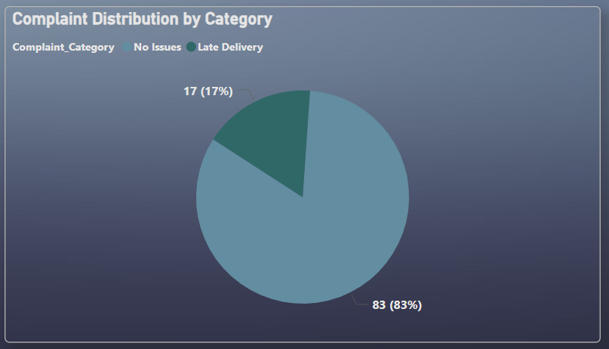
Step 5: Quality Control Analysis
Complaint Classification: We classified complaints into different categories (e.g., product defects, late deliveries, damaged shipments) using logical conditions. This allowed us to pinpoint common issues and their root causes, improving customer satisfaction.
Key Insight: 17% of complaints were related to late deliveries, indicating a need for improved logistics."

Slide 9
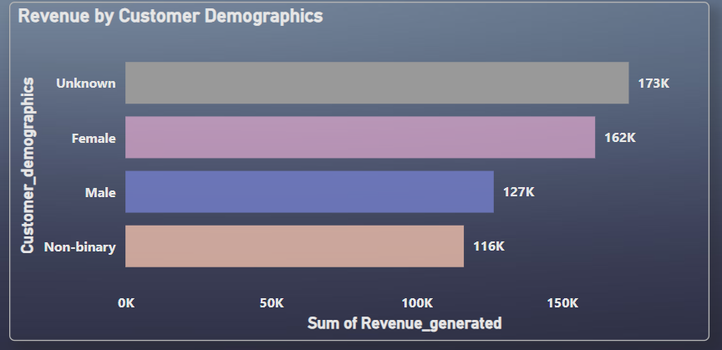
Step 6: Customer Demographics Analysis
Sales by Demographics: Analysed sales by customer demographics to understand the profile of key customers.
This helped in tailoring marketing strategies to target high-value customer segments.
Key Insight: Customers unknown and female contributed to 40% of sales,
making them a key target segment.

Slide 10
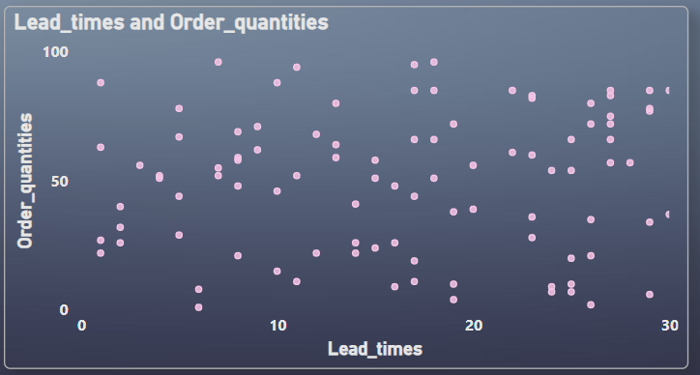
Step 7: Shipping and Logistics Analysis
Shipping Efficiency: Evaluated shipping times and compared them with lead times to identify inefficiencies in the delivery process. This enabled the company to optimize logistics and improve delivery speeds.
Key Insights : Compared shipping times against lead times to identify delays.

Slide 11
Key Recommendations
Improve Supplier Quality: Consider replacing Supplier 2 due to high defect rates. Optimize Inventory: Increase reorder quantities for Product skincare to prevent stockouts. Enhance Logistics: Negotiate better rates with carriers in Region Kolkata to lower shipping costs. Focus on Key Demographics: Tailor marketing campaigns to customers unknown and females aged 25-34.

Slide 12
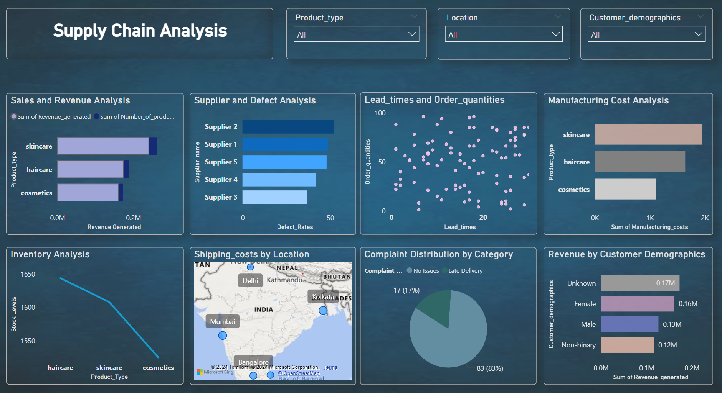
Dashboard Overview
Power BI dashboard allows real-time monitoring of sales, inventory, and supplier performance.

